Slide 1
Certification and Compliance
Raising the bar on Software Quality
Paul Hunkar
OPC Compliance Committee Chair
Consultant Engineer, ABB Process Automation

Slide 2
OPC Compliance
Why Compliance
Reliability, Security, Interoperable, Maintainable …
Plug-N-Play
What is Compliance
Provide tools to assist with interoperability
  Compliance Test Tool (CTT)
  Interoperability Sessions (IOP)
  Independent Test Lab
Provide Information about Product Certification
  OPC Foundation WEB Site
  Logo

Slide 3

OPC Compliance Committee
Formed Summer 2005
Composed of Vendors and End Users
Includes:
ABB
Advosol
Allmendinger
Ascolab
Beckhoff
CAS
Cyberlogic
Emerson
Exxon Mobil
Honeywell
Integrated
Kepware
Matrikon
OSIsoft
Shell
Siemens
SMAR
Yokogawa
Mohawk College
Karel de Grote-Hogeschool
University Of Munich
Hoffman Consulting
Foundation Fieldbus
Software Toolbox
Weyerhaeuser
Technosoftware Inc.

Slide 4
OPC Compliance Committee
Activities
Evaluate Current Compliance
  Generate Survey regarding OPC and Compliance
    Vendor Survey (2006 & 2007)
    End User Survey (2006 & 2007)
Enhanced Certification Program:
  Interoperability Workshops
  Self Certification (Compliance Test Tool)
  Independent Certification Labs
  OPC Foundation WEB Site
  Compliance Logos
  Defining UA Testing

Slide 5
Survey Results
Survey of End Users
  Demographics (1061 respondents)
    End users, automation suppliers, system integrators, consultants
    Oil&Gas, Refining, Chemical, Pharmaceutical, Food&Beverage, Pulp&Paper, Power, Metal&Mining, Utilities, Cement&Glass
Survey of Vendors
  Demographics (875 respondents)
    437 Members; 391 non-members; 52 previous members
    Automation Supplier, Software Supplier, System Integrators, Hardware Supplier, Others, End User , Consultants

Slide 6
Survey Feedback
Sampling of Comments from End User Survey
  The Certification process should include an easily visible "logo" to identify that the software is compliant. The company whose software is certified should provide a means of dispute resolution in the event that two "compliant" products fail to work with each other in a satisfactory manner.
  We are a Consulting Engineering firm for large infrastructure projects (dams, bridges, tunnels, buildings, environmental cleanup, etc.). I work with instrumentation. Cost is not a major issue, but compliance, interoperability, and reliability of the final system is a huge issue as we write specs for projects that may or may not be installed by us.
  THEREFORE, specifying certified products will assist us in making sure multiple brands of equipment can work together properly without us having to describe a lengthy "factory acceptance" testing procedure.
  Certification of compliance to the UA standard will be a "must have" when selecting future OPC products. Business operation cannot be compromised by the risk of buying a non-certified product and finding that something doesn't work.

Slide 7
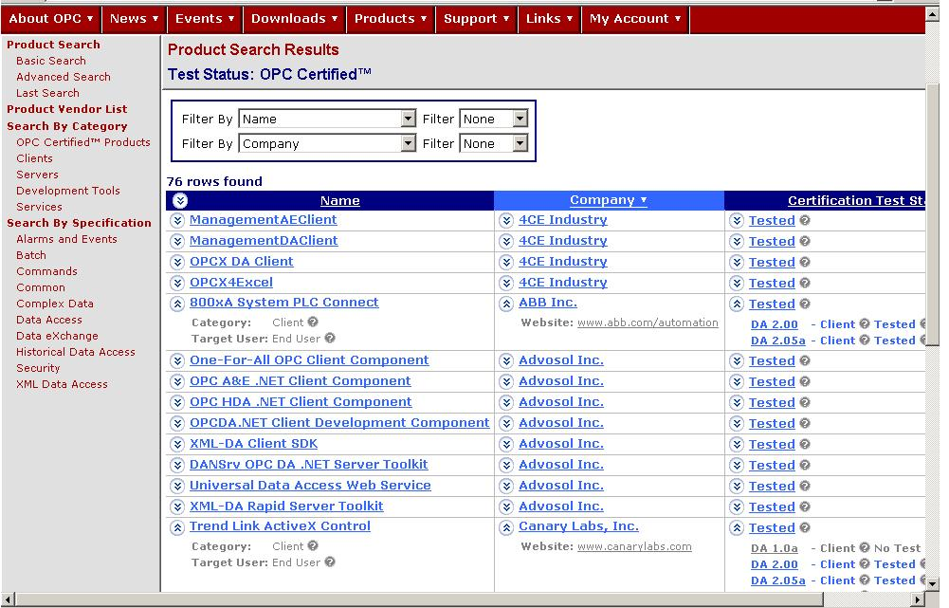
Find Certified OPC Products
Special category shows only certified products

Slide 8
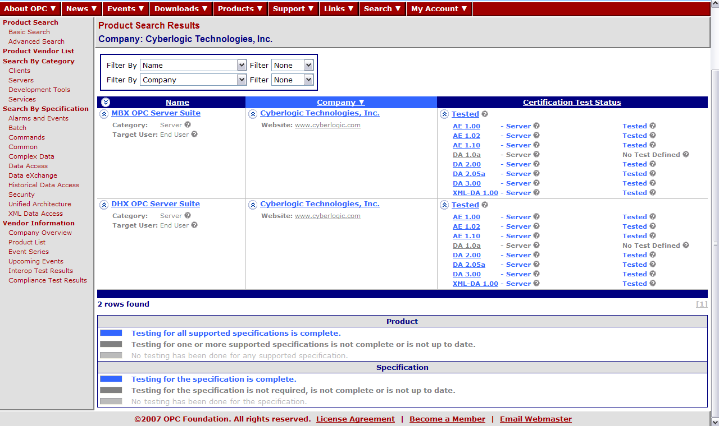
Find Certified OPC Products

Slide 9
UA Testing
What to Test
Profiles
  Separate presentation describing what types of profiles
  Profiles for Server
  Profiles for Clients
When to Test
Have Test Available with Initial Products
How to Test
CTT
IOP
Test Lab

Slide 10
UA Certification
Self Certification Testing
  Defines a test environment
  Defines a set of test cases for each profile
  Runs defined tests against supported profiles
Interoperability Testing
  Ad hoc profile based testing
  Develop tools to assist and verify behavior
Vendor Independent Testing
  OPC Test Lab

Slide 11
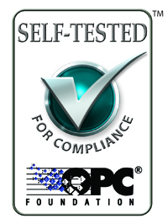
OPC Compliance Test Tool
Current CTT
  For servers (Currently DA, A&E, HDA, XML-DA)
  Provides Self Testing of Server Interfaces
    Verifies Interfaces
    Generates Test Report
  Provides Debugging Support
Started work on OPC UA
  Based on Profiles and Conformance Units
    Will resemble OPC Analyzer
    Will include Information Model Testing
  Will Provide Debug Support

Slide 12
OPC Interoperability Sessions
Allow Clients to be tested against Servers
  Only Place for Clients to be tested
In Europe, US and Japan each year
New Test Tools for IOP (to Improve Client testing)
  Network Interrupt device
  Misbehaving / Logging Server (OPC Analyzer)
Make Software Test Tools Available to Members and for sale to Non-Members
Add UA testing (Initially, own IOP Session)

Slide 13
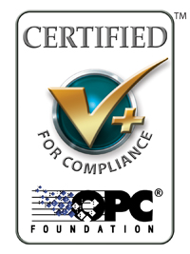
Independent Certification Lab
OPC Certification Labs
  Independent organizations
  Certified by OPC Foundation
Formally Defined Battery of tests
Consulting services
  OPC Training
  Configuration Validation
Available end of Summer 2007

Slide 14
OPC Test Lab - Testing Approach
Manual tests
  Independent test personal required
  Vendor‘s expert attending the test procedure
Automated test suites
  Error Injection server
  Network interrupt Device
  Performance Test Tools
  Load testing Tools

Slide 15
Independent Test Lab
Reproducible Environment
  Fixed Interoperability Test Lab
Functional Tests
  For clients
  Error injection server
Behavior Tests
  For straight forward and exceptional scenarios
Performance Tests
  Including long term and load, reference server
Usability Tests
  Installation / configuration
Environmental Tests
  Real device connection, device failure scenarios

Slide 16


Independent Test Lab
Vendor Feedback Via Survey
  Testing in 2007
    Servers Products - 166
    Clients Products - 155
    Combined Server/Client Products – 158
  Testing in 2008
    Servers Products – 269
    Clients Products – 237
    Combined Server/Client Products – 185

Slide 17
OPC Independent Certification Lab
Survey Feedback
I think it is a very good idea and most likely it will increase the confidence for an OPC server vendor that always let an independent company validate/test their products/OPC servers.
The tests should be sure to incorporate real-world simulations, whenever possible, so that a certified server doesn't crash when the first "non-standard" message or "unlikely" condition occurs in the real world.
That the results of tests be available for general observation so as to provide end users with a more detailed picture of how each product has performed. This should ensure the required/best suited product is selected by any firm

Slide 18
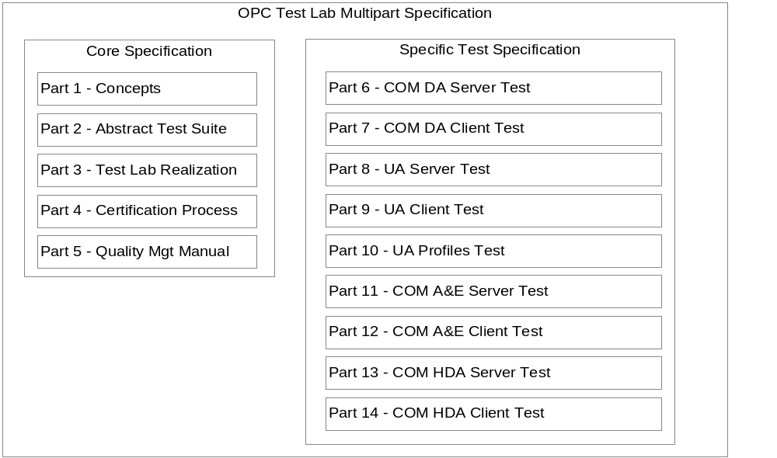
Test Lab Specification
Base Specification Parts 1-5 have been Released
Test Specifications for DA Servers Release Candidate
Test Specification for DA Clients Release Candidate
  Includes Recommended Behavior Description
Test Specification for UA Server nearing completion

Slide 19
Independent Test Lab (Continued)
Tools for Lab
  Logging / Misbehaving server for Client (reused at IOP)
  Performance / Loading clients for Server Testing
  WEB Based management system
    Registration, Testing and Result Reporting
Identified Test Lab Locations
  Three in Europe (Universities and Private Sites)
    Ascolab in Erlangen, Germany
    ITM, University of Munich, Germany
    Karel de Grote-Hogeschool, Antwerp
  North America (Universities)
    Mohawk College
    Additional in progress
  Asia still in progress

Slide 20
OPC Certification Summary
The Compliance Test Tool provides
  Full coverage of server black box test.
The Interoperability Workshop provides
  Compatibility between products based on a set of “typically” used functions
The Test Lab provides
  Reproducible interoperability test, but adds the “real world” environment and validates the behavior
Assignment | Compliance | Interoperability | Laboratory
Black Box Testing | Full | Partial | Full
Performance Testing | Partial | - | Almost Full
Stress Testing | Partial | Partial | Full
White Box Testing | - | Little | Partial
Behavior | - | Little | Full
Environment | - | Partial | Almost Full
Usability | - | - | Full

Slide 21
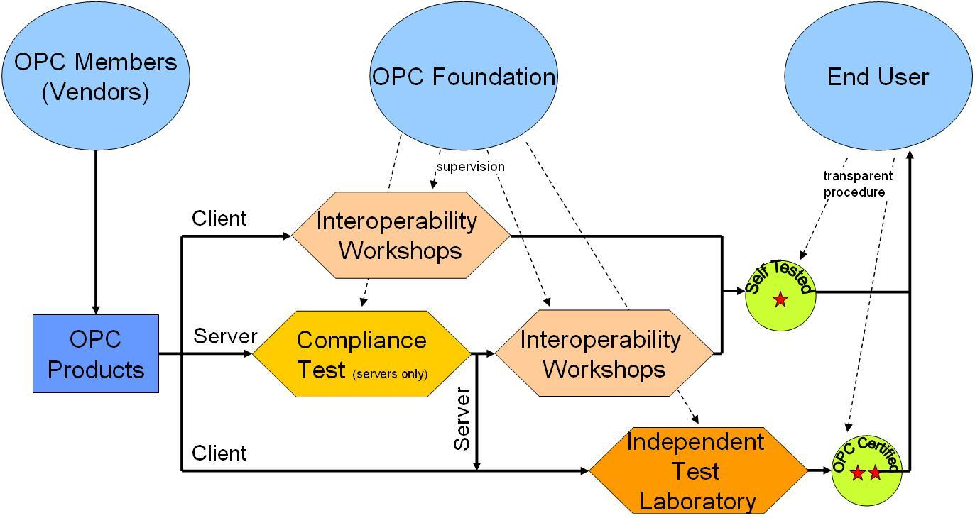
Compliance Summary
Notes:
In summary The OPC Foundation has made a strong effort to provide you the OPC Foundation members tools to enhance and test your products via compliance testing and Interoperability workshops, to independently verify your products via Third party test labs and to publish these results to the end user community via new logo programs. Being an OPC Foundation member and leveraging the Certification and Compliance work will ensure your products work well in the end user environment and are accepted in the end user community

Slide 22

Questions?
Paul Hunkar
Consultant Engineer
ABB Automation Products Division
Paul.Hunkar@US.ABB.com

Slide 23


Test Lab Information
ascolab
  Contractor For OPC Foundation for Compliance Support
  OPC Consulting Services
  OPC Contractor for Compliance
  http://www.ascolab.com
Karel de Grote-Hogeschool Antwerpen
  Existing multi-vendor Factory Automation Research Lab
  Cooperation with a significant number of
  companies (about 70)
  Informal OPC Interoperability testing
  since 1999
  http://www.iwt-kdg.be/fal/

Slide 24


Test Lab Information
Mohawk College
  Existing Industrial and Process Automation Training Center
  http://www.mohawkcollege.ca
ITM, University Of Munich
  An Existing Profibus Test Lab
  An Existing Profinet Test Lab
  http://www.itm.tum.de

